Slide 1

Leukemia Detection
CSE 527 Computational Biology
Andrew Wei, nowei@cs.washington.edu

Slide 2
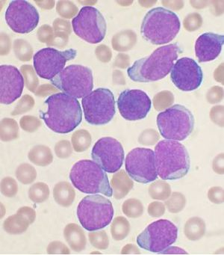
What is Leukemia?
Wikipedia
Notes:
Blood cancer caused by increased abnormal white blood cell production in the body. These blood cells aren’t fully developed and

Slide 3
The Data - GSE13159
Name: Microarray Innovations in LEukemia (MILE) study: Stage 1 data
Data collected from 11 centers across 3 continents
n = 2096 blood or bone marrow samples from acute and chronic leukemia patients
d = 17788 genes
18 sub-types of leukemia

Slide 4
Data breakdown
Name | Count
MDS | 207
CLL | 448
AML complex aberrant karyotype | 52
AML with normal karyotype + other abnormalities | 347
c-ALL/Pre-B-ALL without t(9;22) | 237
T-ALL | 174
CML | 76
AML with t(11q23)/MLL | 38
ALL with t(12;21) | 58
Name | Count
Non-leukemia and healthy bone marrow | 73
c-ALL/Pre-B-ALL with t(9;22) | 122
AML with t(8;21) | 40
ALL with hyperdiploid karyotype | 40
ALL with t(1;19) | 36
Pro-B-ALL with t(11q23)/MLL | 70
AML with t(15;17) | 37
AML with inv(16)/t(16;16) | 28
mature B-ALL with t(8;14) | 13

Slide 5
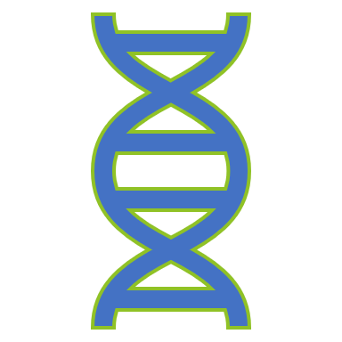
Goal
Understand how gene expression patterns are different in different subtypes of cancer

Slide 6
Approach
90/10 train/test split
Finding significant features (applying Bonferroni correction)
Checking significant features between different subtypes
Seeing most common significant features
Logistic Regression
Checking with significant features/normalization of
Checking similarity between learned weights
Analyzing learned weights
K-nearest Neighbors
Notes:
Tried and true method of throwing things at the wall and seeing what sticks.

Slide 7
Finding significant features
Leukemia sub-type (cont.) | Number of significant features
c-ALL/Pre-B-ALL without t(9;22) | 817
T-ALL | 793
CML | 195
AML with t(11q23)/MLL | 271
ALL with t(12;21) | 724
c-ALL/Pre-B-ALL with t(9;22) | 731
AML with t(8;21) | 373
ALL with hyperdiploid karyotype | 581
ALL with t(1;19) | 612
Pro-B-ALL with t(11q23)/MLL | 689
AML with t(15;17) | 428
AML with inv(16)/t(16;16) | 351
mature B-ALL with t(8;14) | 48
Bonferroni correction (p=0.05, m=17788)
“Non-leukemia and healthy bone marrow” vs. others
Significance found on training set.
1408 significant features in total
Leukemia sub-type | Number of significant features
MDS | 39
CLL | 956
AML complex aberrant karyotype | 220
AML with normal karyotype + other abnormalities | 522

Slide 8

Jaccard similarity of significant features
$$J\left(A,B\right)=\frac{\left|A∩B\right|}{\left|A∪B\right|}$$

Slide 9
Checking the common significant features
Counts

Slide 10
Example: Looking at the most common significant gene
Gene: 10487_at
Shared by: 16 leukemia types
Description: CAP1 - CAP, adenylate cyclase-associated protein 1 (yeast)
Shared by:
CLL, AML complex aberrant karyotype, AML with normal karyotype + other abnormalities, c-ALL/Pre-B-ALL without t(9;22), T-ALL, CML, AML with t(11q23)/MLL, ALL with t(12;21), c-ALL/Pre-B-ALL with t(9;22), AML with t(8;21), ALL with hyperdiploid karyotype, ALL with t(1;19), Pro-B-ALL with t(11q23)/MLL, AML with t(15;17), AML with inv(16)/t(16;16), mature B-ALL with t(8;14)
Not shared by: MDS

Slide 11
Checking significance
Gene: 10487_at
Shared by: 16 leukemia types
Description: CAP1 - CAP, adenylate cyclase-associated protein 1 (yeast)
From [Xie, Shen, Tan, Li, Song, Wang 2017]: “CAP1 […] was under-expressed in breast and leukemia cancers as compared to that in normal tissue.”

Slide 12

Logistic Regression

Slide 13
Learning settings
Used 10-fold cross validation
L1 regularization
With and without significant features
Different normalization schemes
Notes:
L1 because we want a lot of the weights to be 0.

Slide 14
Normalization schemes
Don’t normalize
Normalize across entire dataset
Normalize across normal data in training sample

Slide 15
Results

Slide 16
Comparing Learned Weights
Cosine similarity between learned weights
Notes:
Cosine similarity is a measure of similarity between two non-zero vectors of an inner product space.
So it gives me an idea of how similar the learned weights were to each other.

Slide 17
Most heavily weighted weights

Slide 18
K-nearest neighbors

Slide 19
Results

Slide 21
Future Work

Slide 22
Conclusion

